Slide 1
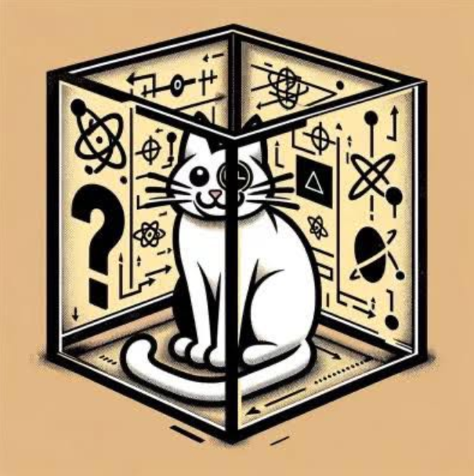
Team Name Is Out of Schrödingers box
Ahmed Badran
Daniel Ehab
Youssif Walid
Omar Ayman

Slide 2
The Idea
Some Items in games are really rare to find and you could need to kill a boss thousands of times to get just this particular item
So we used a quantum random number generator(RNG) to implement a simulation of killing the boss with a set number of times to give the gamers a general idea of the drop rate of the item they seek
Users would first input the boss they want to kill then input the number of times they intend to kill the boss
Then the simulation starts and the user is given an output of all the items they could receive as well as how much of each item

Slide 3
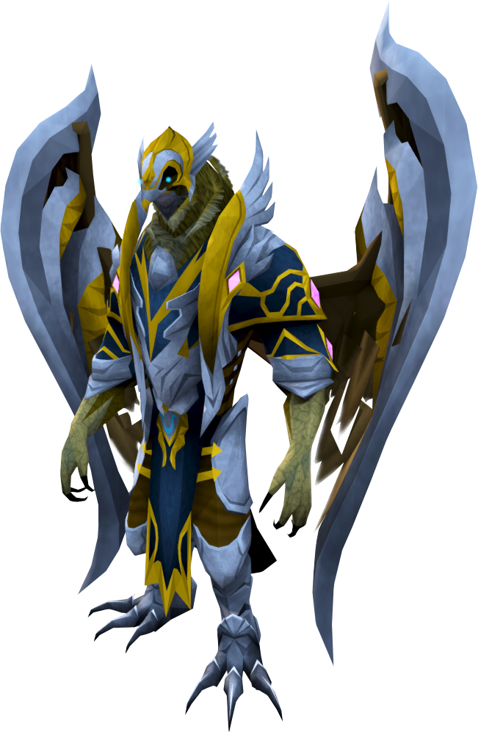
Case Study:
A boss from RuneScape called Kree'arra
This Boss has around 24 different possible drops
Each drop has a certain rarity ranging from common to rare
Using data provided by the game wiki page, we derived a calculation to integrate the RNG into the items list to provide an accurate simulation of killing the boss in-game

Slide 4
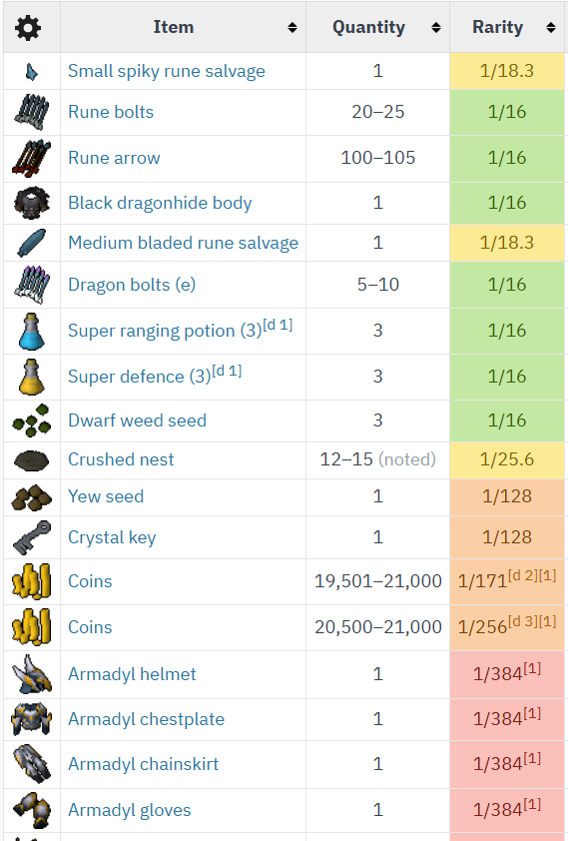
Here we can see the data of the possible items dropped by the boss and their rarity and to briefly explain what this means:
On average you need to kill this boss 384 times to get an Armadyl Helmet
As you can see some items are harder to get than others and players reported that to get the whole Armadyl armour set they needed to kill the boss around 4000 times, some people get lucky and needed to kill the boss 100 times while others had to go over 12,000 and still not get the whole set
The data from the Wikipedia was based on a statistic of killing the boss 116,905 times. And to utilize the RNG in accurately representing the rarity, we used this formula: item(n) range = max (item n-1)+1 -----> max(item n-1)+1 + 116,905*rarity
In our code we gave each item a lower bound and upper bound in which if the RNG generated a number in that range, the boss drops that item in that kill
For example we take item 1: small spiky rune salvage: its lower bound=0 and upper bound= 0 + 116,905*1/18.3=6388
and item 2: rune bolts: lower bound = 6388+1=6389 upper bound=6389 +
116,905*1/16=13,695
As we can see, each item has a distinct range of numbers and the rarer the item is, the shorter its range is therefore the harder the RNG to reach it
However for simplicity in our code we took the sample number to be 131,072 (exactly 2^17) instead of 116,905

Slide 5
Advantages of QRNG Over Classical methods
QRNG produces truly random numbers
Better Security (Random Quantum numbers are difficult to predict)
Fairness

